Slide 1
Networking
GA Outcomes

Slide 2
Agenda
Networking
What is Networking
Connections vs. Transactions
The Network You Have
The Network You Build
Asking For Things
Assignment and reading materials

Slide 3

Networking Feelings
What is your first thought when you hear the word “networking”?
On a scale of 1-5,
(5 = very comfortable)
how comfortable are you with networking?
Boston Outcomes

Slide 4
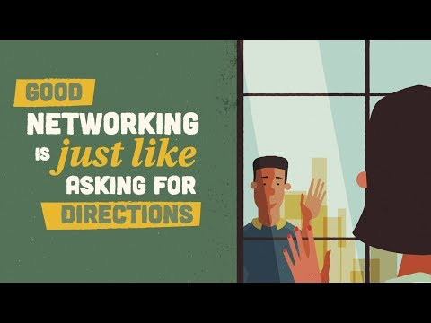
Notes:
https://youtu.be/j8cfh6WdHn0

Slide 5


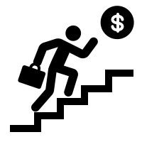
Why should I network?
Community & Professional relationships
Exposure
Opportunities
Notes:
By interacting with other professionals in the industry- hiring managers, recruiters, employees – you will stand out
Get a valuable inside look at a job from someone who works in the industry every day.
Learn about the people i.e. their career story and design or improve yours
Learn about new organizations and opportunities
Learn the lingo and the trends in the industry and geography

Slide 6
Why should I network?
According to recent research, 70% - 85% of jobs are found through networking
Learn about the hidden jobs: around 70% of jobs are not public

Slide 7
Networking in your personal life
How did you learn about GA and this course?
How did you meet your best friend/spouse?
Who influenced/helped you in making your recent big purchase?
Boston Outcomes
Notes:
Answers: Referred by friend/family member/colleague, saw an ad, met in person/attended an event, Online search. Hiring decision are also made similarly. If you are referred by a colleague or a friend the chances that you will be interviewed is very high compared to just applying online.

Slide 8
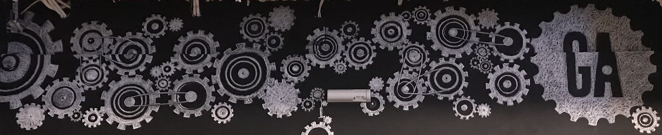
The Network You Have
Networking

Slide 9
Who Is In Your Current Network?
Friends
Family
____________
____________
____________
____________
YOU
Boston Outcomes

Slide 10
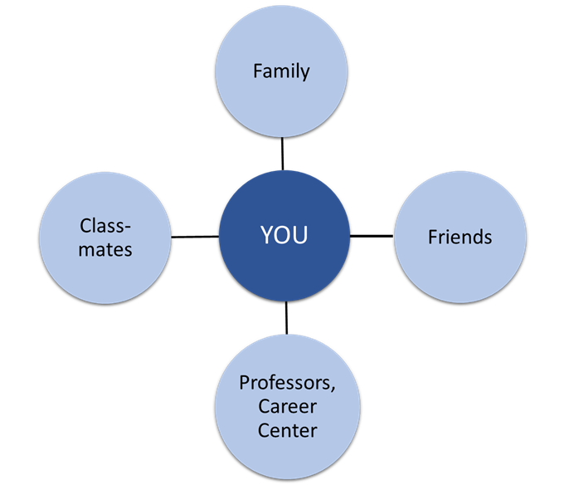
Recognizing Your Network

Slide 11
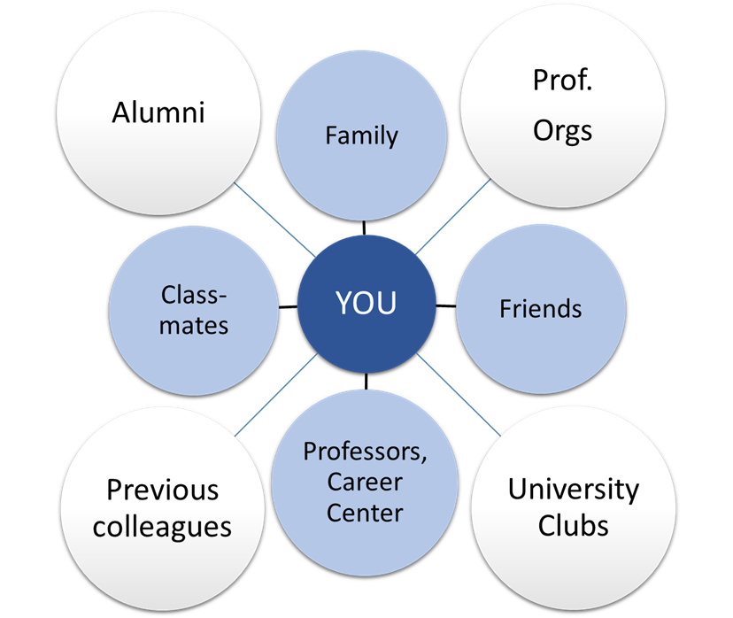
Expanding Your Network

Slide 12
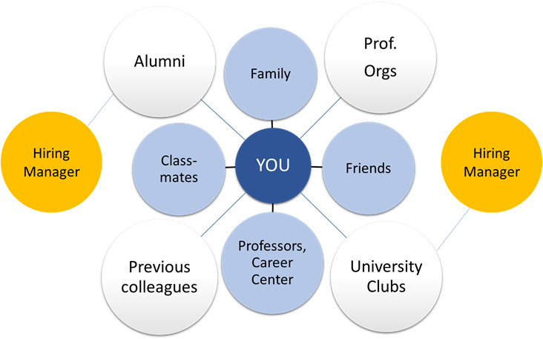
Your next opportunity is in your network

Slide 13

Engaging Your Network
Sharing your story
Sharing your learnings/experience/advice
Think about:
What are low-lift ways to stay in touch?
What are ways you can offer value?
What is advice you would benefit from getting?
Boston Outcomes

Slide 14
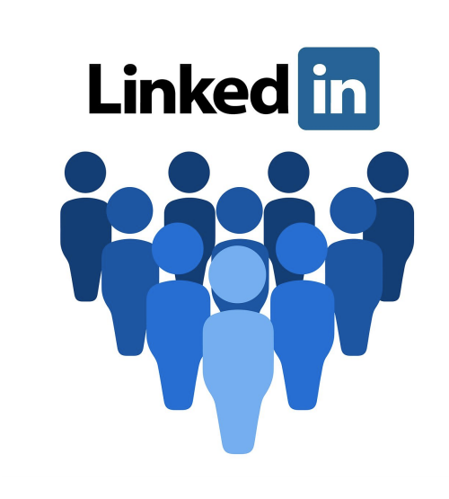
Networking in a Pandemic
LinkedIn and other online networks are more important than ever!
Professional relationships look different, but they haven’t disappeared.
What are other ways to stay connected?

Slide 15
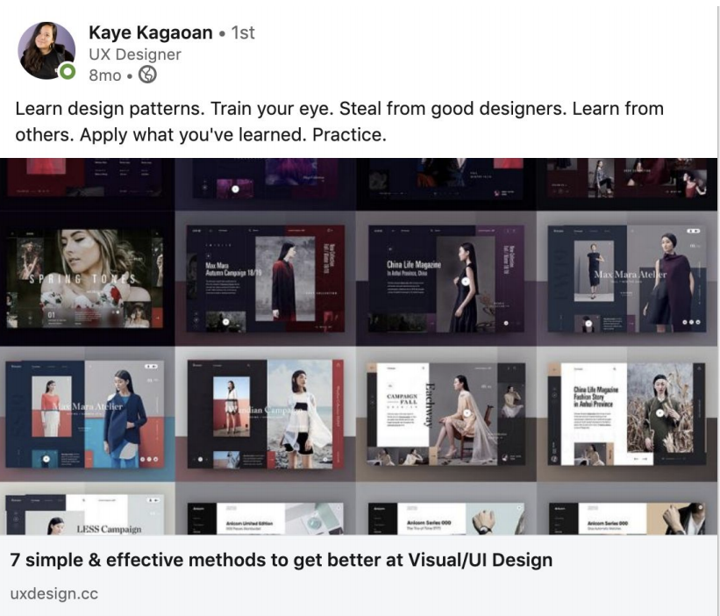
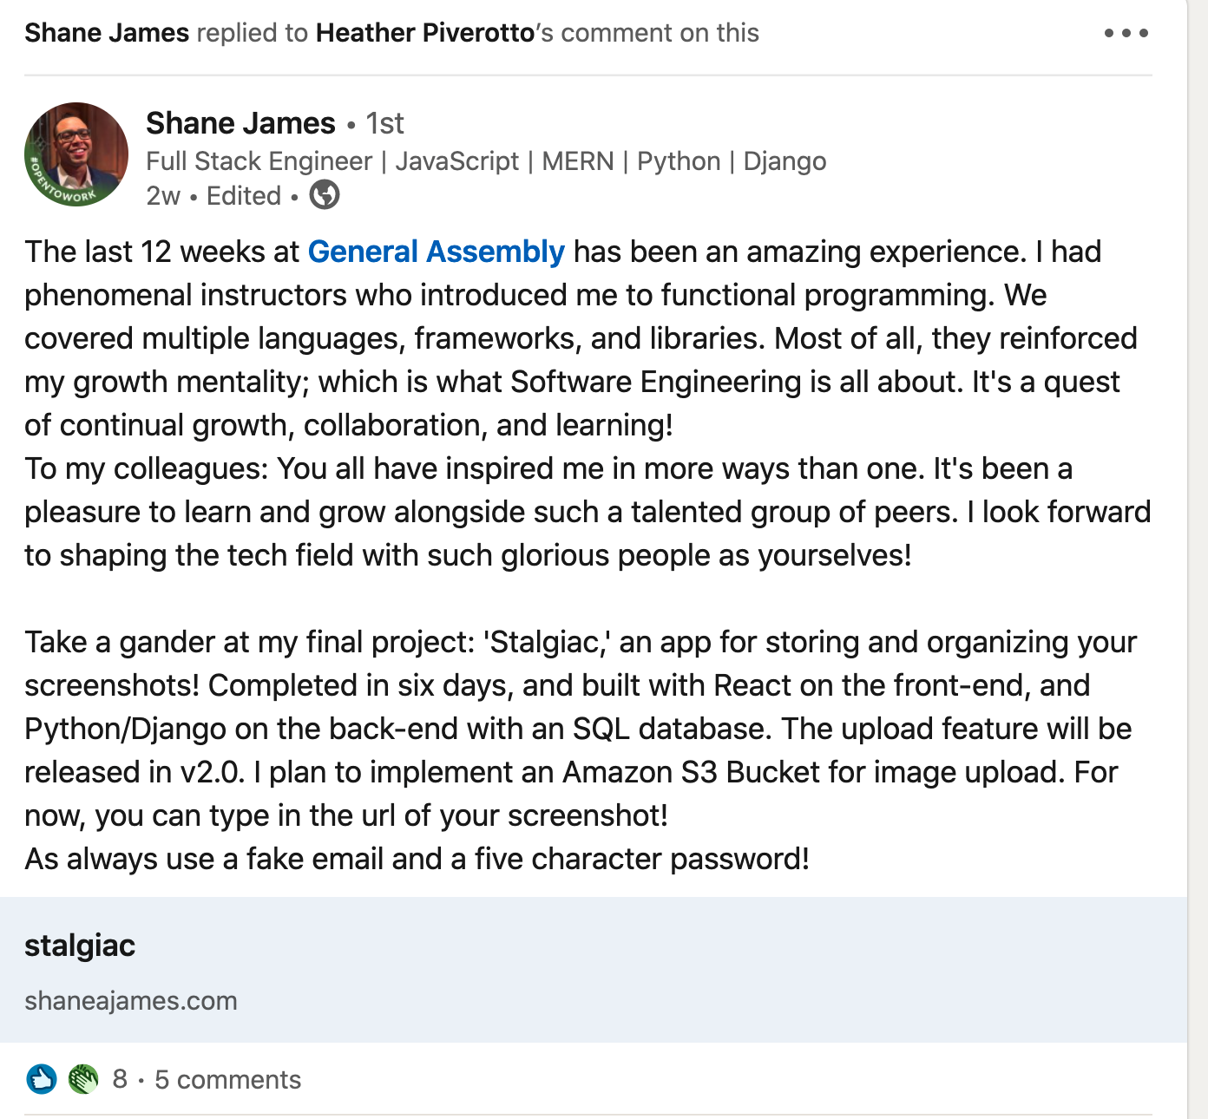
Networking in a Pandemic: Thought Leadership
Reshare content, add value.
Tell stories, express gratitude.

Slide 16
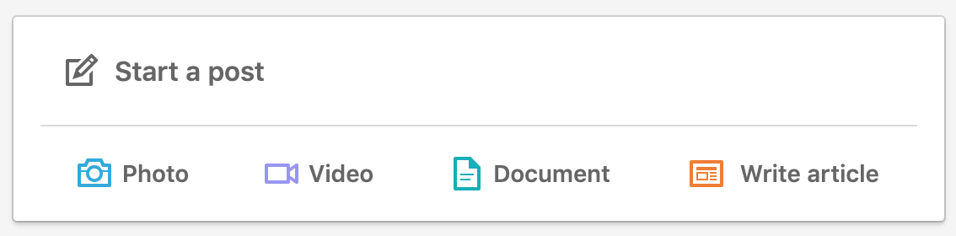
Do Today or This Week
Start drafting a LinkedIn post about something exciting that you’ve done recently! (A project, perhaps?)
Boston Outcomes

Slide 17
The Network You Build
Networking

Slide 18
Who Do You Want To Add To Your Network?
____________
____________
____________
____________
YOU
Boston Outcomes

Slide 19

Expand Your Network
Warm Introductions: “Can you introduce me to…”
Cold Introductions
Networking Events
Open Source Projects, Hackathons, and Design Challenges
Meetup.com events
Buddy System
Topic-Specific Events
Hobby Events, Social Events
What else?
Boston Outcomes

Slide 20

Do Now
Find an online community, affinity group, or local resource. Google things like…
“Black in UX”
“Data science Austin network”
“Slack groups for developers”
“Neurodiversity in tech”
“Seattle UX design news”
Boston Outcomes

Slide 21
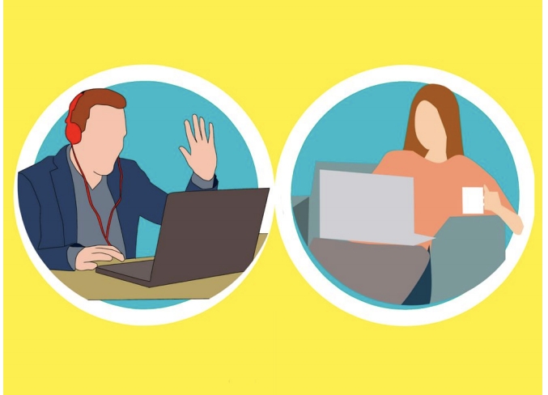
Networking in a Pandemic
Yes! Networking is still happening in the COVID-20 era.
Virtual events
Slack communities, e.g. NYC UXPA and Women Who Code
Online workshops, classes, and panels
Hackathons
Virtual career fairs
Zoom birthday parties (seriously)
And this great big list of tech conferences that have gone virtual due to COVID-20

Slide 22
Asking For Things
Networking

Slide 23

Notes:
https://youtu.be/m6Pa4ZB4mvQ

Slide 24

Curiosity Conversations
AKA Informational Interviews
Once you have rapport, ask for a 1:1.
Make a clear ask
Offer multiple avenues: phone, chat, video
Offer to assist them
Ask for advice
Prepare questions
Be considerate of their time
Thank them
Boston Outcomes

Slide 25




4 steps to following up
Make an in-person connection
Connect online: LinkedIn, Twitter, Email, etc.
Send a “great meeting you” message with a clear call to action
Set a second date
Boston Outcomes

Slide 26
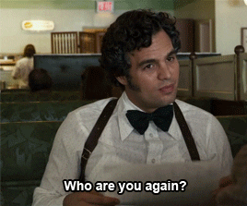
Following up is time sensitive.
The longer you wait, the more likely they’ll forget who you are.
Boston Outcomes

Slide 27
Networking 201 (Advanced Job Search Method)
GA Outcomes

Slide 28

Traditional Job Search Methods - Pros and Cons
‹#› | © 2022 General Assembly
Notes:
Traditional = Spray and pray = 100% online apps

Slide 29
Traditional Job Search Methods - Pros and Cons
Passive
Ineffective
Rarely work for career changers
Used for filtering applications
No feedback
Frustrating
‹#› | © 2022 General Assembly
Notes:
Traditional = Spray and pray = 100% online apps

Slide 30

Alternative Methods - Efficient but take more effort
LAMP Method (from The 2-Hour Job Search book)
Uncover the Hidden Job Market
‹#› | © 2022 General Assembly

Slide 31
2HJS Method (from The 2-Hour Job Search book)
Pros:
You are incharge of the process
Efficient way to get interviews
Cut through the noise and go beyond the ATS and recruiters
Takes less than 2 hours to set up
This system works (if followed diligently)
Increase your professional network
Cons:
Doesn’t offer instant gratification like applying online
Results might take some time
Notes:
Ramesh

Slide 32
2HJS Method
Prioritize target employers (LAMP List)
Contact target employers (Outreach)
Convince new advocates to provide internal referrals (Informational Interviews)
Notes:
Ramesh

Slide 33
LAMP List Overview
L
List of Employers: Dream employes, employers who have hired alumni, employers with current postings, and trending employers
A
Advocates/Alumni: Do you have connections at this company already? (Yes/No)
M
Motivation: On a scale of 0-3, how excited are you about this company/role?
P
Postings: How many postings does this company have?
Sorting Your List: Sort first by Motivation (largest to smallest or Z to A), then by Postings (largest to smallest or Z to A), then by Advocacy (Z to A)
Next Steps: Outreach and Informational Interviewing
Notes:
Ramesh

Slide 34
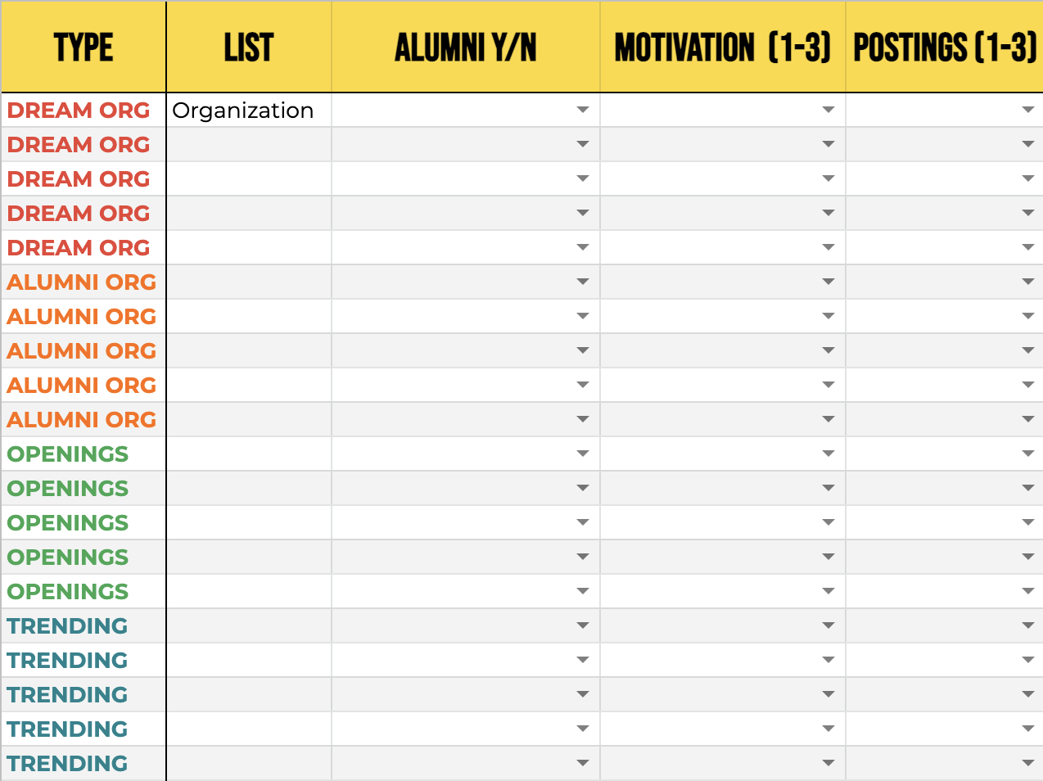
Pre-work: Employer List
Notes:
Ramesh

Slide 35
LAMP Creating the List of Employers (40+) - 5 min
Your “Dream Employers”
Employers who hire GA graduates
Employers who hire your alma mater graduates
Who have current, relevant job postings
Trending employers (those doing interesting things)
“Top 10 list” in your city
Think beyond the big brand employers. Small and medium size companies employ almost 90%.
‹#› | © 2022 General Assembly
Notes:
Less competition, good pay and great for starting your career.

Slide 36
LAMP Alumni/Advocates Column - 5 mins
Enter Y or N
Use LinkedIn custom search
Schools field: “General Assembly”
Current Companies field: Enter each employer name
Repeat step 1 with your “alma mater” in the school field
Do friends or family work there?
Do previous colleagues work there?
Did your teachers, professors, instructors, coach work there?
‹#› | © 2022 General Assembly

Slide 37
LAMP Motivation Column - 5 mins
Scale of 0-3
Favorites - 3
Good/Sure - 2
Low-tier - 1
No information or Opinion - 0
‹#› | © 2022 General Assembly

Slide 38
LAMP Posting Column - 5 mins
Which employers have active, relevant job postings? Go to Indeed.com and search employer name and keywords in “What field”
Relevant results - 3
Employer has job postings - 2
No results or irrelevant results - 1
‹#› | © 2022 General Assembly

Slide 39
Sorting your list
Highlight your list and sort in this manner (In Google spreadsheet, first select the small box above row 1 and beside column A, then go to Data tab → Sort Range → Advanced Range Sorting Options → check “Data has header row”)
Sort first by Motivation (largest to smallest or Z to A)
Then by Postings (largest to smallest or Z to A)
Then by Advocacy (Z to A)
‹#› | © 2022 General Assembly
Notes:
Focus on your target employers who are currently hiring.

Slide 40
Sorting your list
Highlight your list and sort in this manner (In Google spreadsheet, first select the small box above row 1 and beside column A, then go to Data tab → Sort Range → Advanced Range Sorting Options → check “Data has header row”)
Sort first by Motivation (largest to smallest or Z to A)
Then by Postings (largest to smallest or Z to A)
Then by Advocacy (Z to A)
Analyse the results. Research and update motivation scores for those in the top 10 with low M scores but high A and P scores. Now repeat the above steps and evaluate your new top 10 list.
‹#› | © 2022 General Assembly
Notes:
Focus on your target employers who are currently hiring.

Slide 41
Next: Contact
Identify 2 contacts at each company in the top 10 list
Find their contact information using:
LinkedIn groups
Alumni databases
LinkedIn and other social media profiles
Use an email finder (E.g. Hunter.io)
Send a LinkedIn connection
Warm intros
If you have multiple contacts at the same company, look for these traits: Function > Alumni > Seniority > Other Affinity > Fan mail > Cold email
‹#› | © 2022 General Assembly

Slide 42
Reach Out
The 5-point email/message
Fewer than 100 words
NO mention of jobs anywhere
Ask for insight and advice, nerve for job leads or referral
Connection goes first
Generalize your interest
Maintain control of follow-up
‹#› | © 2022 General Assembly

Slide 43
Example (DSI)
Subject: GA DSI alum seeking your advice
Dear Mr. Jay,
My name is Lucy Carroll and I recently completed the Data Science Immersive bootcamp at General Assembly. I read your blog article on Medium.com and was very impressed with your your approach to solving business problems using data and your job search advice. I am currently researching different careers in the tech industry and would really appreciate your insights as a fellow bootcamp graduate. May I have a few minutes to ask you about your experience at XYZ company?
Best regards,
Lucy LinkedIn/Portfolio (URL)
NOTE: Don’t use acronyms like GA, DSI when reaching out to people who are not General Assembly alumni.
To be safe it’s better to mention the full-form of any acronyms in your communication and job search materials. Unless, it’s a commonly used term in the industry e.g. SQL

Slide 44
Track
Use 3B7 method for top 5 target employers
Set two reminders in your calendar anytime you sent an email to a new contact - #1 3 business day later, #2 7 business days later
If you receive a response before the first reminder, schedule an informational interview ASAP
If no response within 3 business days (i.e. before the first reminder), initiate outreach to second contact at the company
If no response is received before reminder #2 appears, follow up with the original contact
‹#› | © 2022 General Assembly
Notes:
(Ramesh)

Slide 45
Follow-up email example
Hi Jay,
Thank you for your quick response and willingness to chat. Over the next few days, I am available in the evening from 3:00pm to 6:00pm EST everyday and all day of Friday. Will any of those times work for you? Thank you again.
Lucy
‹#› | © 2022 General Assembly

Slide 46
Next: Recruit (Informational Interviewing)
Research
Individual - LinkedIn, blog, etc.
Company - About section, annual/quarterly reports, webinars, newsletters
Industry - Industry publications, professional associations, mentors
Google both interviewer and employer for any negative headlines
Prepare
Tell me about yourself.
Why are you interested in our company?
Why are you interested in our industry and/or function?
Watch this recording to learn more about informational interviewing.
‹#› | © 2022 General Assembly

Slide 47

Questions?

Slide 48
Assignment
Networking

Slide 49

Homework Assignment
See the assignment posted in Google Classroom.
Boston Outcomes

Slide 50
Additional Resources
6 Ways To Network More Effectively [Forbes Article]
The art of active networking
[TED Talk]
Networking Skills [Slideshare]
How to Win Friends and Influence People [Dale Carnegie Book]
How to Build Your Network
[Harvard Business Review]
How to Succeed in Business Without Really Trying [Musical]
Boston Outcomes
Notes:
Start now

Slide 52
Connections vs. Transactions
Networking

Slide 53
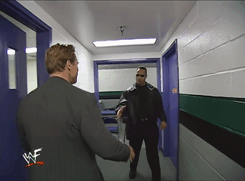
Making Connections vs. Making Transactions
It’s a lot like friendship.
Boston Outcomes

Slide 54

Authentic Networking
You’ve been learning to build human relationships your entire life.
You can (and should!) be your authentic self as you build professional relationships.
Stretch your comfort zone, but know your own style and strengths.
Boston Outcomes

Slide 55
Relationship Marketing
Focus on their needs, not yours.
Make it easy for them to connect with you on their terms.
Always ask, how can I offer more value? (Giver vs Taker)
Engage them by telling your story.
Ask for advice.
Hubspot's Ultimate Guide to Relationship Marketing
Boston Outcomes

Slide 56


Warm Introductions
GA guide to asking for warm introductions
Establish Connection 1
Identify Connection 2
Be clear about your motivations and intentions
Make it very easy
Thank them
Boston Outcomes

